Slide 1
AWS Application Deployment
Vibe Coding with Terraform & AWS
Razin Bin Zaidun

Slide 2
Agenda
Introduction to Vibe Coding & Terraform
How Terraform works & interacts with AWS
Why use Terraform together with AWS
Cost Optimization
Summary & Recommendation

Slide 3
Introduction

Slide 4
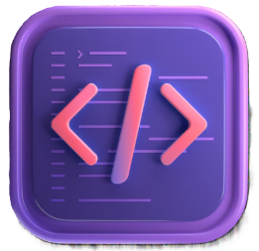
What is Vibe Coding?
Vibe Coding
Vibe Coding is a modern development methodology that prioritizes velocity and architecture over syntax. Instead of manually writing every line of code, we act as the “Architect”, describing the desired outcome to AI tools (Gemini or LLMS) which handle implementation details.

Slide 5

What is Terraform?
Terraform
Terraform is an infrastructure as code (IaC) tool. It allows for the definition of cloud resources (servers, databases, networks) in human-readable files. Instead of operating the cloud’s platform dedicated website and CLI.

Slide 6
How it works
Write Code
Write code (main.tf), declaring what desired state is needed. (E.g., “I need a S3 bucket”)
Plan
Terraform compares the code to the live AWS environment and calculates what needs to be changed.
Apply
Terraform authenticates with AWS using the API keys provided by the user and automatically builds or updates the resource.

Slide 7
System Architecture
Frontend (S3)
Static React application hosted on AWS S3. It provides the user interface for user to input their data.
API Gateway
Acts as the secure front door, handling HTTP requests, CORS policies, and throttling before routing to the backend.
Backend (Lambda)
Serverless Python function that executes the logic and required assessments for the application to run.

Slide 8
Why Serverless & IaC
Scalability
AWS Lambda scales automatically from 0 to 1000s of requests without managing any servers. Resource is only used when the code runs.
Automation
Terraform allows the definition of the entire infrastructure in code. This eliminates “ClickOps” and manual errors in the console.
Speed
Using “Spec-Driven Development”, from idea to deployed architecture is possible in under an hour or two by leveraging AI for boilerplate.

Slide 9
Why Use Terraform
Lesser Human Errors
Manual console clicking leads to human errors like incorrect API key values. Terraform ensures the infrastructure is built the same way every single time.
Reproducibility
Terraform can destroy the environment to save costs and rebuilt it up within minutes with a single command.
Flexibility
Infrastructure is stored as code (main.tf), allowing us to track changes, rollback errors and even collaborate via Git.

Slide 10

Cost Optimization
Leveraging AWS Free Tier
By utilizing AWS free tier, we secure 1 million Lambda requests per month, allowing the application to scale to thousands of users without incurring computing costs.
Serverless Execution
Serverless architecture ensures zero idle server costs. Nothing is active when the application is inactive.

Slide 11
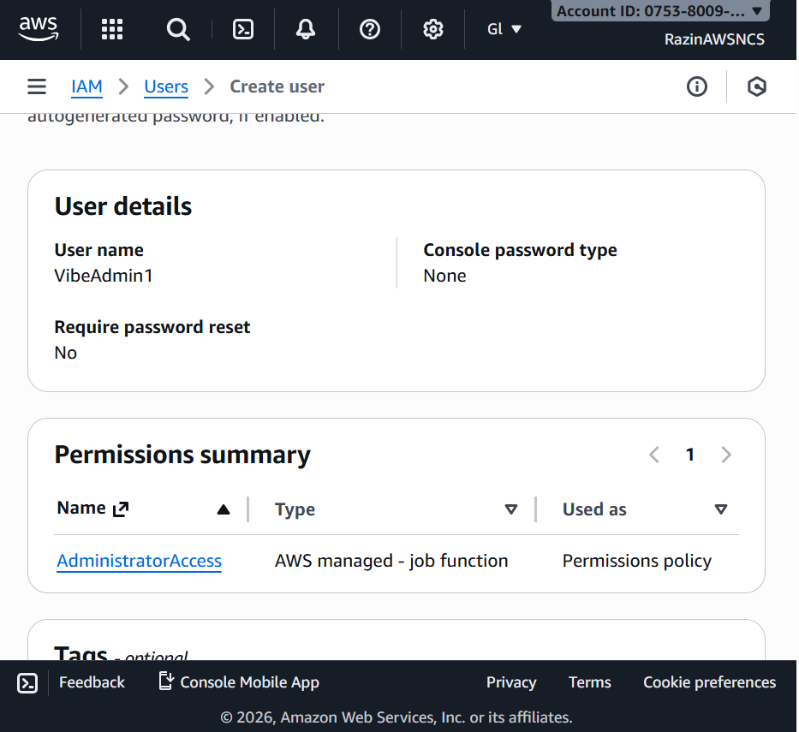
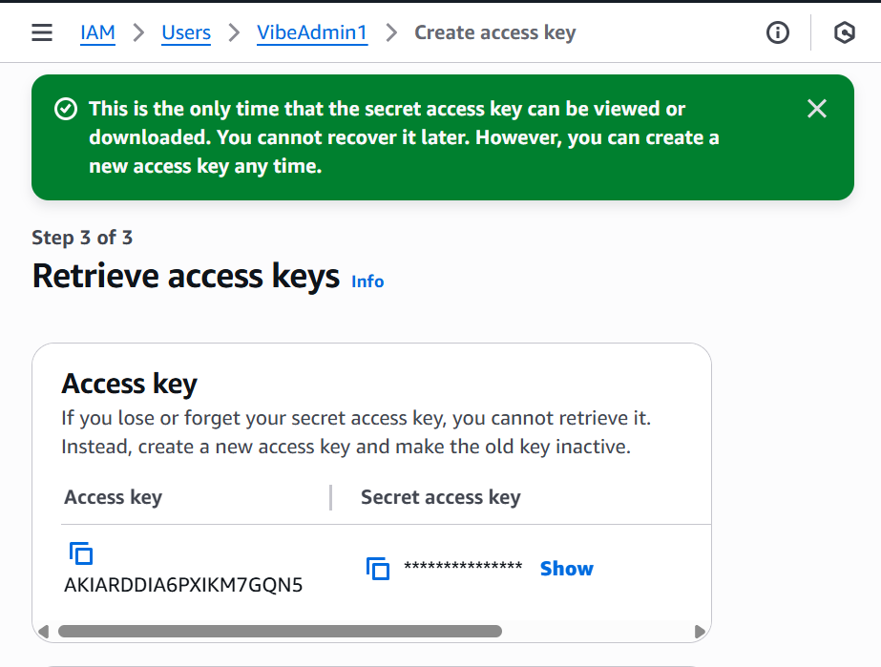

Slide 12


Slide 13
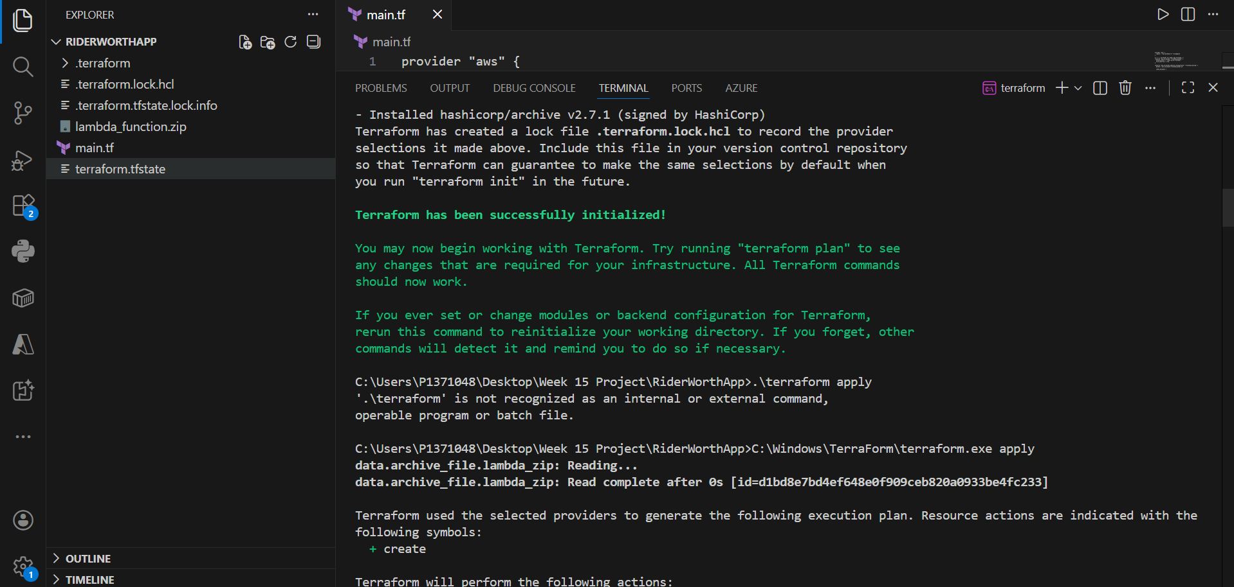

Slide 14
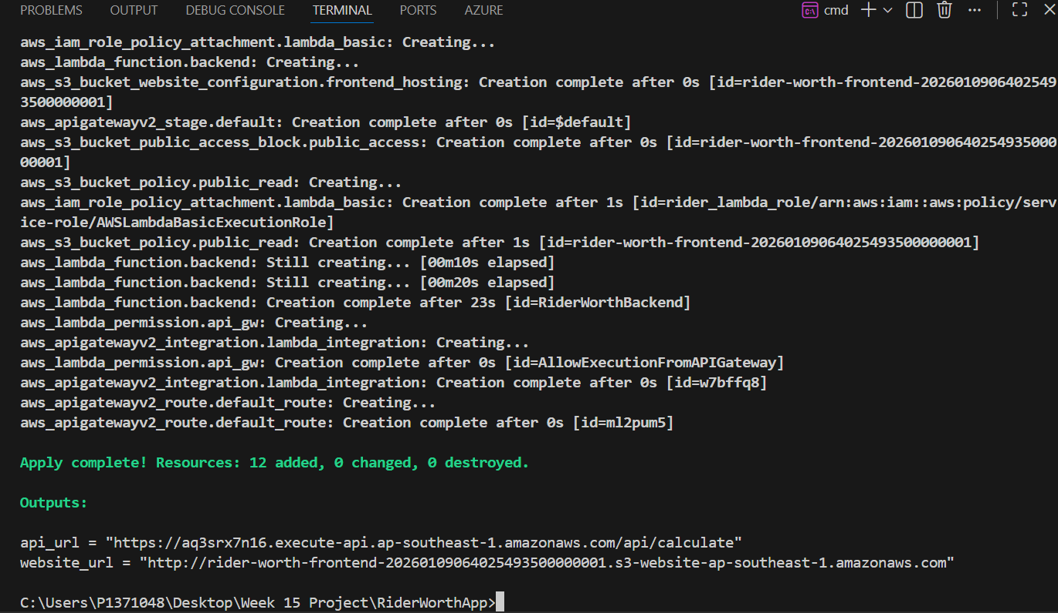

Slide 15
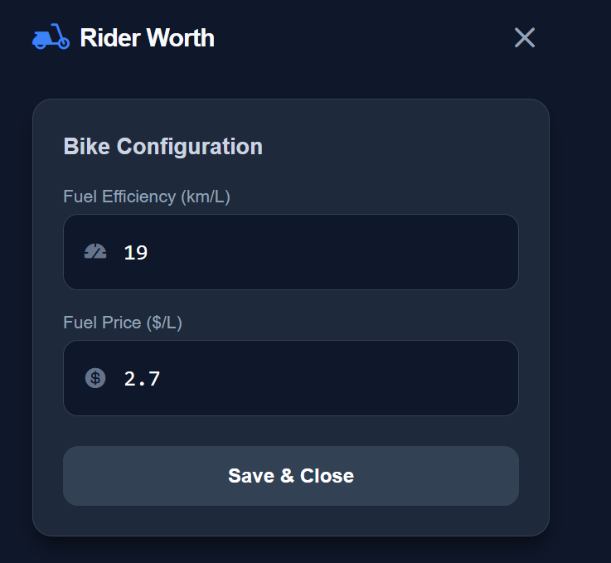
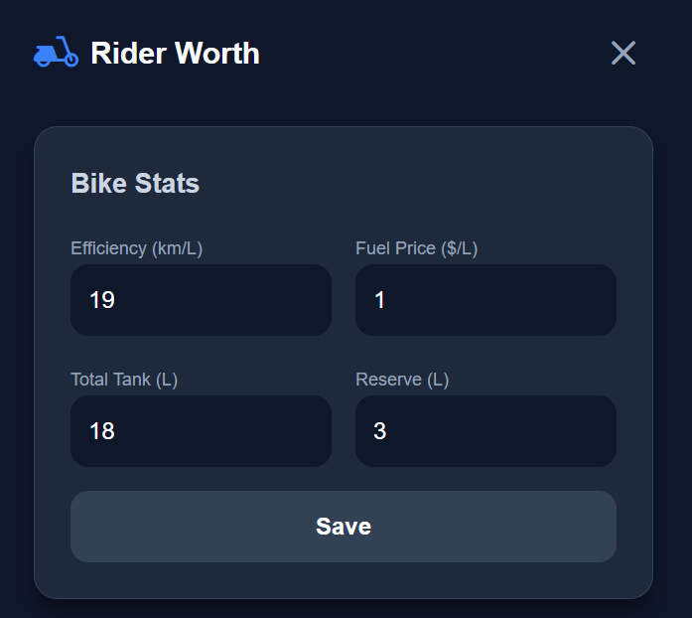

Slide 16
Activity Flow

Slide 17
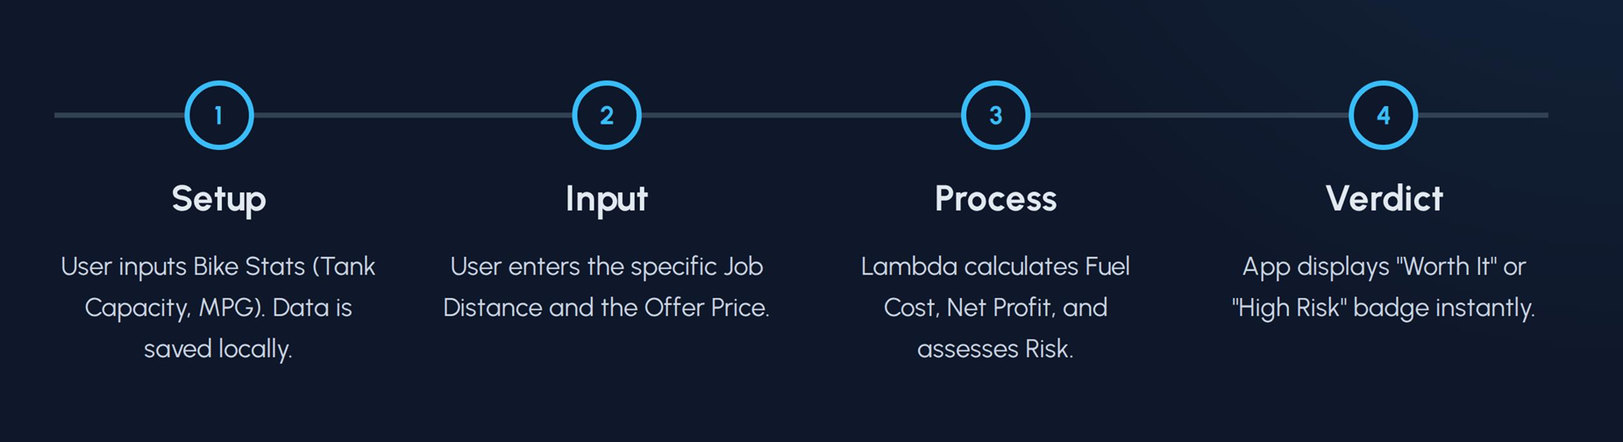
Activity Flow

Slide 18
Deployment Challenges and Solutions

Slide 19

Challenges
Infrastructure Drift
  Managing the sync between manual AWS Console changes and the local Terraform state file to prevent overwrites.
  Overcoming it:
  Modified it on the Terraform local copy as it is the master copy which when ran, Terraform triggers the resource activation and utilization in AWS.

Slide 20
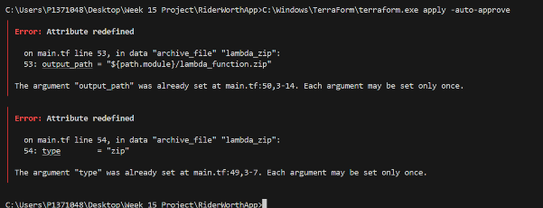
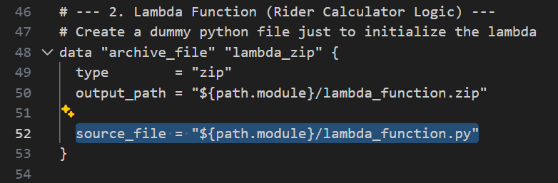
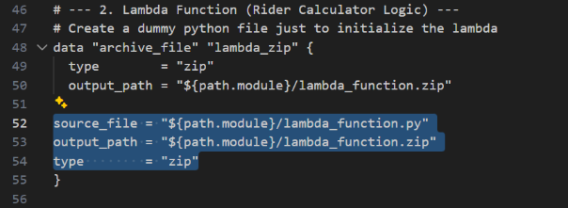

Slide 21
Challenges
Network Security
  SSL verifications failed due to the firewall and corporate proxy restrictions during the CLI operations.
  Overcoming it:
  Had to run the ignore the SSL verification for application uploading, which does open the payload to attack from external sources. Mainly done so for testing purposes.

Slide 22
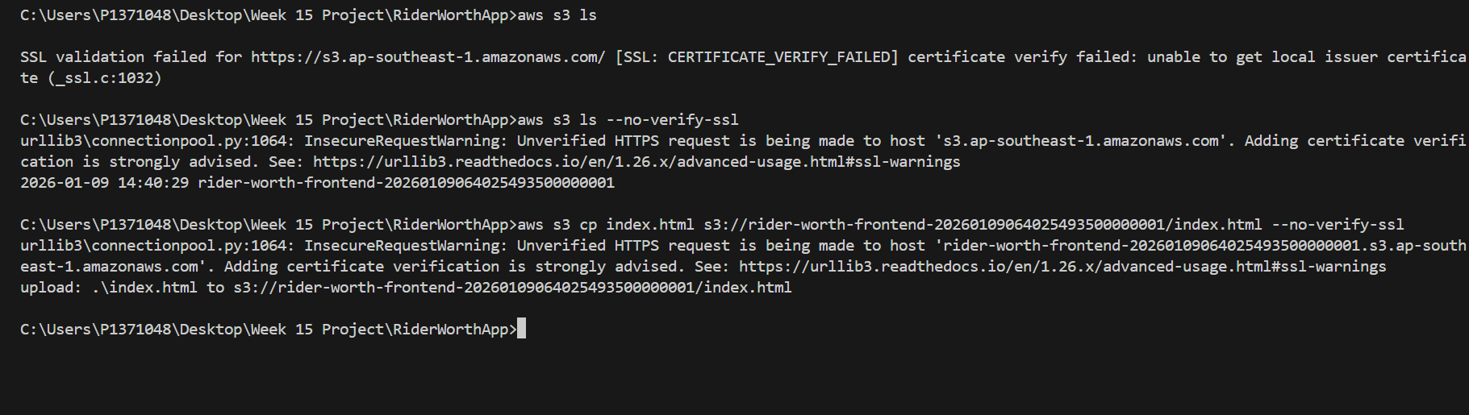

Slide 23
Learning & Takeaways

Slide 24
Learning & Takeaways
Area | What I Learned | Impact
Infrastructure as Code | Cloud resources should be defined in code (Terraform) rather than created manually, ensuring consistent configuration. | Eliminated "ClickOps" and enabled reproducible deployments across environments.
Vibe Coding | Leveraging AI to handle implementation details ("The How") allows me to focus purely on Architecture and Logic ("The What"). | Accelerated development velocity from days to hours for full-stack prototypes.
Security First | Security features like Input Validation and Throttling must be baked into the infrastructure layer, not just the app logic. | Prevented API abuse and ensured robust error handling from Day 1.

Slide 25
Summary and Recommendations

Slide 26
Summary
Full-Stack AWS Deployment
Successfully integrated a Python Lambda Backend with a modern React Frontend hosted on S3, demonstrating end-to-end cloud development capability using Infrastructure as Code.
Operational Intelligence
The application moves beyond simple calculations by integrating "Risk Analysis" based on fuel capacity and reserve limits, providing riders with actionable, real-world decision support.
Secure & Robust Architecture
Implemented enterprise-grade security practices within the Free Tier, including API Throttling to prevent abuse and strict Input Validation to handle edge cases gracefully.
The Vibe Engineering Model
This project proves that combining AI-driven code generation with architectural engineering allows for the rapid delivery of secure, production-ready prototypes in a fraction of the traditional time.

